Slide 1
DIPLOMA IN PYTHON PROGRAMMING ADITHKUTTAPPAN 4250

Slide 2

Why this course?
Easy to understand ;Python’s redability,non-complexity and ability for fast prototyping contribute to its popularity
Libraries: Python comes with numerous built-in libraries that are well suited for data mining, machine learning and AI
Easier,more powerful implementation: with python,pprogramers spend less time writing code and debugging errors compared with other languages
Syntax:python uses modern scripting and friendly syntax
Broad support:Python’s support community is large,increasing its popularity even more

Slide 3
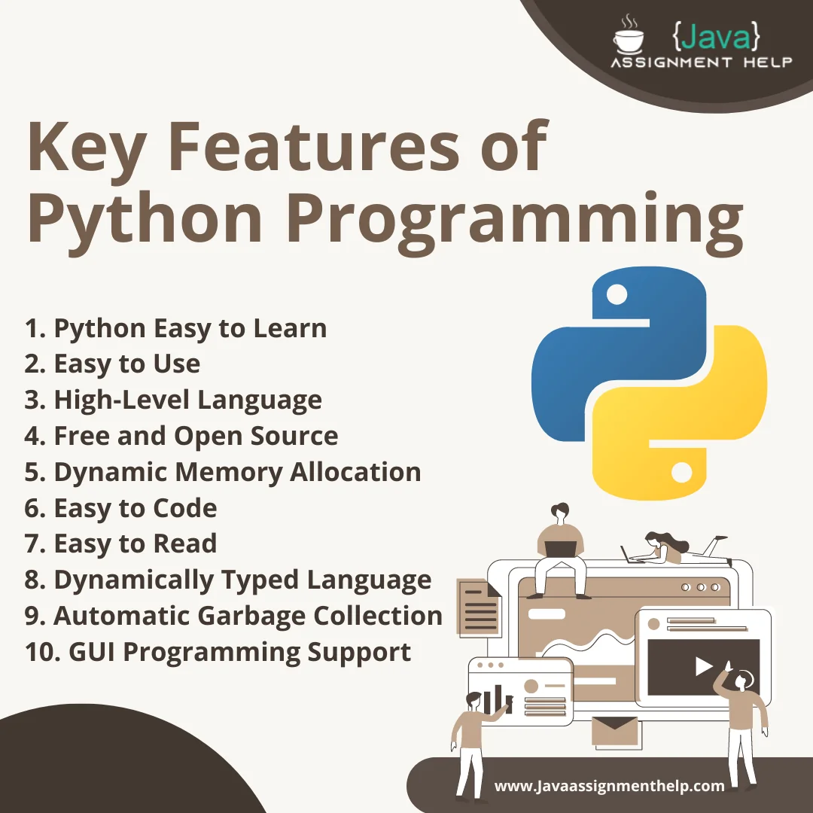
overview
The diploma in python programming is afunctional course designed to equip students with essential programming skills using python ,one of the most popular and versatile programming languages today. The course cover core concepts such as variables , data type , control structure, functions , object-oriented programming, file handling, and error management . Students also gain hands – on experience by working on practical projects that involves real-world applications like data analysis web development and automation .This course is ideal for beginners and aspiring developers who want to build a strong base in programming and prepare for advanced learning in software development, data science, or machine learning
Total time :the course is 25 hours course

Slide 4
Thank you

